Slide 1
2025 Community Mental Health Survey Trust Webinar 2
19th June 2025

Slide 2
Agenda
Overview of 2025 Survey [5 mins]
Sampling and contact approach [10 mins]
Potential sampling errors [5 mins]
Service-user facing materials [10 mins]
Questionnaire development: survey questions [10 mins]
Data Protection and Section 251 requirements [5 mins]
Demographic Batch Service (DBS) checks [5 mins]
Instruction Manuals [10 mins]
Entering Fieldwork [5 mins]
Key dates [5 mins]
Questions [5 mins]

Slide 3
Overview of 2025 survey

Slide 4
Overview of the 2025 Community Mental Health Survey
Run annually
Participation
Survey has run almost
every year since 2004.
50 Community Mental Health Trusts (CMHT) participate.
Mixed mode
Sample
Survey can be completed online, paper (postal), telephone.
Service users who attended CMHT during April and May 2025.
Accessibility
Eligibility
Survey available in Large Print, Braille, Easy Read, 10 different languages. BSL and can call interpreter for help in 22 languages.
Must be at least 16 years old to participate and had two contacts, one during sampling period and another during, before or after.

Slide 5
Sampling and contact approach

Slide 6
Sampling
Eligibility criteria:
Service users aged 16 and above accessing either Children and Young People Mental Health Services, Adult Mental Health Services or Older People’s Mental Health Services; AND
With at least one contact (face-to-face, via video call or telephone) between 1st April and 31st May 2025 (the sample period), AND
With at least one other contact (face-to-face, video call, telephone) either before, during or after the sampling period.
Submission of a boosted sample:
The sample size is a minimum of 1,250 service users; BUT
Trusts are strongly encouraged to submit a boosted sample.
Submission of additional sample records increases the possibility of reporting at a granular level.
Benefits: Receive feedback from a larger number of service users, potential for reporting by assessment service group and by service or team type.
For the 2025 iteration of the community mental health survey, sampling variables will remain the same as they were for 2024.

Slide 7
Contact approach
Contact | Type | Content of contact | Days from first mailing | Example of mailing days
1.0 | Postal | Invitation letter with URL and QR code for online survey. Multilanguage sheet with QR codes. | 0 | Monday 18 August
1.1 | SMS | SMS reminder (if phone number available). | 7 (5 working days after contact 1.0) | Tuesday 26 August – pushed to Tuesday as Monday falls on a bank holiday (25th August)
2.0 | Postal | Reminder letter with URL and QR code for online survey. Paper Questionnaire. Freepost return envelope. Multilanguage sheet with QR codes. | 14 (10 working days after contact 1.0) | Monday 01 September
2.1 | SMS | SMS reminder (if phone number available). | 21 (5 working days after contact 2.0) | Monday 08 September
3.0 | Postal | Reminder letter with URL and QR code for online survey. Paper Questionnaire. Freepost return envelope. Multilanguage sheet with QR codes. | 28 (10 working days after contact 2.0) | Monday 15 September

Slide 8
Potential sampling errors

Slide 9
Check sample prior to submission
Examples of checks you should do before submitting your sample:
Check the attendance criteria has been correctly applied – ensure the sample includes service users who have had at least one ‘face-to-face’ contact that is in person, via video conferencing or by telephone during the sampling period (this could include an initial assessment) AND had at least one other contact (face-to-face, video conference, telephone, or email) either before, during or after the sampling period.
Check last contact date –the last date the service user had contact with NHS mental health services, during or after the sampling period (April to May 2025). As the sample is drawn in July 2025, we would expect there to be a large proportion of service users with a last contact date between April and June 2025.
Check you included 16- and 17-year-olds in your sample.
Ensure service users on the national data opt-out programme are not excluded.
Ensure service users who have dissented to taking part are excluded.
Ensure you have not excluded an eligible service user group.
Are there any errors in the query used to extract the eligible population?
Are there any missing / incomplete data in your initial database?

Slide 10
Check sample prior to submission: continued
Examples of checks you should do before submitting your sample:
Ensure there is no incomplete address data – all records should have enough postal information to ensure the letter would be successfully delivered, and ensure valid correct postcodes are included when available.
Check all codes provided in your sample are valid.
Make sure local and DBS checks are undertaken by the trust:
Local checks must be conducted by the trust before mailing one and should be conducted for mailing two and three. If your contractor is able to run DBS checks for you, local checks are optional before mailing two and three.
DBS checks are required before the first mailing, and recommended before mailings two and three.
Check Sub – ICB code is correct and matches ODS document (as updated in July 2022).
Check the mobile phone number is correct – no landline numbers are included; check there are 11 digits in each number.
Be aware of system migrations, as they can lead to downtime which can delay drawing your sample or introduce significant shifts in the demographic proportions compared to the previous survey year.
Make sure you have randomly sampled.
Check there are no filters on columns before drawing the sample.
.

Slide 11
Sample declaration form
Completing the Sample Declaration Form can help avoid errors. Avoiding errors will ensure your questionnaires can be mailed out earlier and your data will be usable in this year’s survey. This includes:
Sample Figures.
Checklist (with list of Sub-ICB codes)
Declaration Agreement: to be signed by person drawing sample and Caldicott Guardian
Submission
Sample declaration form to be submitted to your contractor (or the SCC if an in-house trust).
→ Once the sample declaration form has been approved, please submit your sample safely via secure file transfer site.
Tips
Take care to fill in dates
Schedule time for sign-off in advance with Caldicott Guardian

Slide 12
Service-user facing materials

Slide 13
Service-user facing materials
Minor changes were implemented for these documents in 2025.
Covering letters
Multilanguage sheets
Minor text amends made to the first and last covering letters.
No changes made. The sheet offers 19 non-English langauges. Nine of these have a QR code which links straight to the survey in that language. Service users whose first language is not English would read the sheet in their preferred language where available.
SMS guidance
Posters: Dissent &
16/17 year olds’ leaflet
No changes made.
Text and formatting changes made to the dissent poster and the 16/17-year olds’ leaflet.

Slide 14
Cover letter changes
Additional covering letter text
To make the survey more appealing and to drive up the response rate, additional text was added to the first covering letter:
“The best way for us to improve our care is by hearing from people who have recently used our services. Last year, almost 15,000 adults used the survey to tell the NHS about their care and help improve services in the future. Your voice matters more than ever - share your experience in the NHS survey and help shape better care for everyone.”
Changes to the last covering letter:
Text has been changed to ‘we recently sent’, instead of stating the month, as month can differ depending on when the trust entered fieldwork.

Slide 15
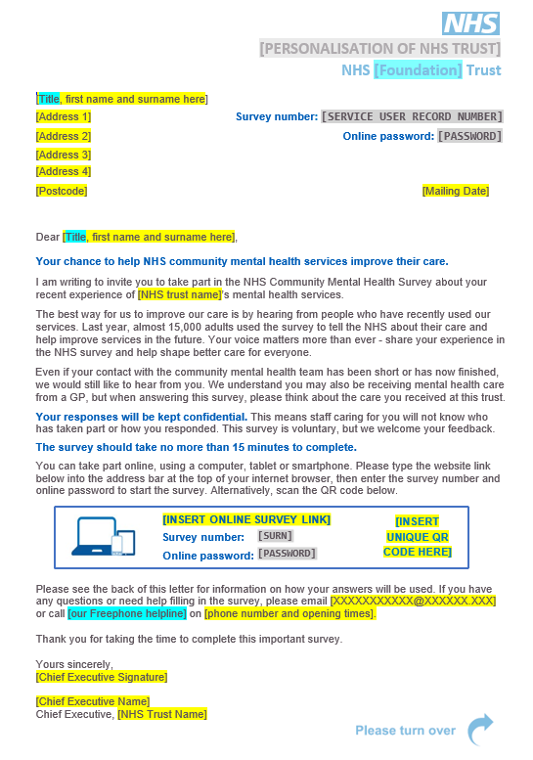
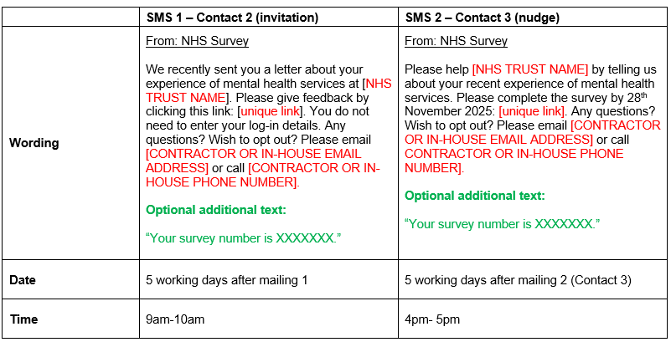
Letters and SMS reminders

Slide 16
Dissent poster change
Additional text
Section 251 approval wording has been included at the bottom of the poster, on request from Confidentiality Advisory Group, to inform service users that the survey has approval to process contact details.
Also available in:
Arabic
Bengali
Gujarati
India Punjabi
Italian
Kurdish Sorani
Polish
Portuguese
Romanian
Spanish
Ukrainian
Urdu

Slide 17
16/17-year-olds leaflet changes
Text and formatting amends, based on Trust Webinar 1 feedback:
Text reviewed to prompt service users to “look out for your survey invitation in the post”, flagging that invitations will be sent in August and September 2025.
Headline changed to make it more appealing and engaging to service users.
Bolded text included which informs service users they will be asked to fill in a survey about their mental health care, which they can complete online or on paper.
Icons included to make the leaflet more visually-appealing for readers and to replace the headings in the FAQ section.

Slide 18
Other survey materials: publicity
Press Release Template
Social Media Cards
Website Banner
Infographic
Outlines the purpose and value of survey for trusts.
Applies “You said, We Did” principles to demonstrate how patient feedback has been implemented.
Can be tailored to demonstrate how research findings have been used to identify areas of improvements and action change.
Provides information about the purpose, value and dates of the survey.
Includes: 1x call to action, 1x reminder pre-fieldwork and 3x reminders during fieldwork.
Can be shared by trusts and national organisations on social media platforms like Facebook or LinkedIn, or printed to use as leaflets.
Highlights the message of helping to improve community mental health services by completing the survey.
Includes: 3x simple banners.
Banners can be added to websites, email signatures and any other platforms as appropriate.
Provides 2024 survey results, for trusts to share with service users on social media platforms, trust website, newsletters, emails, and/or to be displayed as a poster on site.
The infographic maximises reach and increases engagement and participation in the survey.

Slide 19
Accessibility options
As per previous iterations of the Community Mental Health Survey, there are a variety of accessibility features available for the online survey and paper questionnaire to ensure all service users can complete the survey in line with their individual needs.
Via online survey
A A
Change font size
Change background colour
Screen reader compatible
Multiple language options
British Sign Language
Large-print questionnaires
Easy Read
Braille
Language line: option to contact a telephone-assisted helpline to request help to complete the survey. Help is available in approximately 22 languages.
Via contractors on request

Slide 20
Questionnaire development: survey questions

Slide 21
Development process
In line with the 2023 and 2024 Community Mental Health Surveys, this year’s survey will continue to use a mixed-mode methodology: online survey and paper questionnaire.
March / April 2025
May / June 2025
July – August 2025
Engagement Trust Webinar: to discuss the use of 2024 materials, and to understand what common platforms are used with service users, how could promotional materials be further amended to ensure usability across platforms.
Stakeholder consultations: to understand their service user populations and what mechanisms they use to engage with service users.
In-depth interviews with service users: to understand what encourages them to complete a questionnaire, their preferred method of contact, survey mode and channels to promote a survey. It was explored what quality care looked like to them, and what is most important in the care they receive.
Advisory group: to understand stakeholder priorities regarding community mental health, and current policy.
Cognitive interviews: 60-minute virtual interviews with 24 x service users from various demographic backgrounds who had recently utilised community mental health services.
Second Trust Webinar: to discuss sampling process and questionnaire amendments for 2025.
Finalising the questionnaire and online survey.
Trusts should draw their samples.
Full details will be available in the Survey Development Report

Slide 22
New questions for CMH25
Question | Rationale
MOVING TO ADULT MENTAL HEALTH SERVICES FROM CHILDREN AND YOUNG PEOPLE'S MENTAL HEALTH SERVICES Children and Young People's Mental Health Service (CYPMHS) are services that support young people, between 11 – 18 years old. The move to Adult services, if required, takes place when young people turn 18 years old. The following questions ask about your experiences whilst moving to Adult services. | In the 2023 survey, we tried to explore the transition experience, but did not have sufficient responses to report on the questions. This year we are trying to include the transition experience due to continued interest from stakeholders. Adding in 5 questions on service users experiences transitioning from Children Young People’s Mental Health Services to Adult Mental Health Services. Questions will be kept the same as 2023, to explore the possibility of combining data years if responses data remains low. These questions will be only included in the online survey and to those aged 16-25 years, due to audience and paper questionnaire restrictions.
In the last six months have you moved from Children and Young People's services to Adult Mental Health services?
Did you feel you were given enough information about what would happen during your move to Adult services?
Did you feel you got enough support from your NHS mental health team when moving to Adult services?
Did you experience any changes in your care after you moved to Adult services?
Has your family or someone else close to you been involved in planning your move to Adult services?

Slide 23
New questions for CMH25
Question | Rationale
Have you been given a diagnosis for your mental health? | The new question provides understanding on whether service users have been given a diagnosis. The question provides opportunity for service users to flag if they received a diagnosis, but it has changed in the meantime. The question also includes a response option that allows service users to opt out of the question if deemed to be sensitive to them. Stakeholder feedback noted that people are not always receiving a diagnosis, but that everyone should have a clear diagnosis.
Did your mental health team tell you who to contact if you had any questions or concerns about your care or treatment? | Stakeholders agreed that the survey should include a question about service users knowing whom to contact if they have questions or concerns between appointments. They also felt that people should have a named contact for any questions or concerns. Feedback from the service user interviews is that patients don’t always know who to talk to.

Slide 24
Amended questions for CMH25
Question | Rationale
In the last 12 months, have you been receiving any prescribed medication for your mental health needs? | Question amended by combining the two previous questions in the ‘Your Treatment’ section: In the last 12 months, have you been receiving any medication for your mental health needs? Who prescribed medication for your mental health needs? This amend has been added as the majority of respondents consistently report that they receive medication, so it seemed sensible to combine to one question, allowing for a new question to be added without increasing the number of questions in the survey.
A crisis is if you need urgent help because your mental or emotional state is getting worse quickly. You may have been given a number to contact, such as a ‘Crisis Helpline’, ‘NHS 111 mental health option’ or a ‘Crisis Resolution Team’. | NHS 111 mental health option has been included to this text. Mental health crisis support can now be accessed through NHS 111-phone line, mental health option. This amend has been added as feedback from trusts showed that there was mixed interest in capturing service user experience of NHS 111. NHS England are also keen to explore this area.
Would you know who to contact out of office hours within the NHS if you had a crisis? | The explanation text ‘This should be a person or a team within NHS mental health services’ has been removed.

Slide 25
Amended questions for CMH25
Question | Rationale
Did your NHS mental health team involve you in a plan for your care? | People using mental health services jointly agree on a care plan with staff. In the 2024 survey we included questions asking if they had a care plan, along with whether they were involved in agreeing it. Stakeholder feedback noted that a service user’s care plan should focus on their goals and aspiration and both the service user and staff should be involved in creating it. Stakeholders wanted to move away from a focus on ‘agreeing’ the plan, as some service users will have been involved but not all will agree with the plan put in place. Cognitive interview feedback showed that the previous question asking about extent of involvement was too complicated and subject to interpretation. Therefore, we introduced a more simplified question.

Slide 26
Amended questions for CMH25
Question | Rationale
In the last 12 months, have you contacted NHS mental health crisis support? Please cross ✗ in ALL the boxes that apply to you. (Online questionnaire wording: Please select ALL the answers that apply for you) | The question provides the service user with options to feed back what crisis care support they utilised. Based on feedback from trusts and stakeholders, the question now includes NHS 111 mental health option, text support, local crisis service and A&E options. An explanation text was included to flag to service users that this is a multiple-choice question.
Thinking about the last time you contacted NHS mental health crisis support, how did you feel about the length of time it took you to get through to someone? | Question amended to get clarity on how long it took service users to get through to NHS mental health crisis support. The question was changed to past tense. Question amended to explicitly state ‘NHS mental health crisis support’.
Thinking about the last time you contacted NHS mental health crisis support, did you get the help you needed? | Question amended to explicitly state ‘NHS mental health crisis support’.

Slide 27
Amended questions for CMH25
Question | Rationale
In the last 12 months, did your NHS mental health team give you any help or advice with finding support for… ...Joining a group (e.g. art, sport etc) ...Finding or keeping work …Help with money or benefits | Question amended by combining the previously-two response options (“Financial advice or benefits” and “Cost of living”), which stakeholders agreed are capturing the same aspect, into “Help with money or benefits”. It was fed back that this simplifies the language in this question.
At birth were you assigned as … | Question amended to “at birth were you assigned as” in order to keep consistent with text that follows.

Slide 28
Questions removed from CMH25
Question | Rationale
Do you feel in control of your care? | Question removed due to stakeholder feedback that this information is already covered by other questions in the survey, such as questions related to involvement and choices.
Do you have a care plan? This is a plan for any care and treatment you may receive. | Trusts expressed that the term ‘care plan’ is mostly or always used when in discussion with service users, but that the language around the ‘care plan’ can be misleading as it is not always a specific document and might be incorporated within a clinical letter. This question was removed and a question focused on their involvement in their plan of care was added.

Slide 29
Questions removed from CMH25
Question | Rationale
In the last 12 months, did your NHS mental health team give you any help or advice with finding support for…Cost of living | This question has been removed due to stakeholder feedback to combine the “In the last 12 months, did your NHS mental health team give you any help or advice with finding support for…Financial advice or benefits” and “In the last 12 months, did your NHS mental health team give you any help or advice with finding support for…Cost of living” questions into one (“In the last 12 months, did your NHS mental health team give you any help or advice with finding support for…Help with money or benefits”).
Who prescribed medication for your mental health needs? | This question has been removed due to it being combined into another question: “In the last 12 months, have you been receiving any prescribed medication for your mental health needs?”.

Slide 30
Data Protection and Section 251 Requirements

Slide 31
General Data Protection Regulation (GDPR) & National Data Opt-Out Programme
National Data Opt-Out Programme
General data protection regulation (GDPR)
NPSP has received exemption from the National Data Opt-out Programme.
How service users’ personal data is being protected under the GDPR is stated on the reverse side of the covering letter for mailings 1-3:
We will continue to have separate opt-out mechanisms via the dissent posters that need to be displayed across all trusts.
Please note that service users do not have to actively consent to the sharing of their data, for the 2025 Community Mental Health Survey.

Slide 32
Section 251 requirements
We ask you to publicise the survey both internally and externally to ensure service users are aware of the survey and have the opportunity to opt-out should they wish. Example materials are available in the 'Publicising the survey’ document.
You can also use the publicity materials we will provide you with.
Ensure a log of service users who have dissented from taking part in the survey is accurately kept.
Ensure the total number of eligible service users who have dissented from the sharing of their details for any purpose other than their clinical care or who have dissented from taking part in the survey specifically are recorded in your sample declaration form and are excluded from your sample.
Section 251 allows service user data to be shared outside of NHS trusts without gaining prior and explicit consent from these service users. In order for their contact data to be shared without consent to a third party, you have to display the dissent poster and provide 16/17-year-old service users with a leaflet.

Slide 33
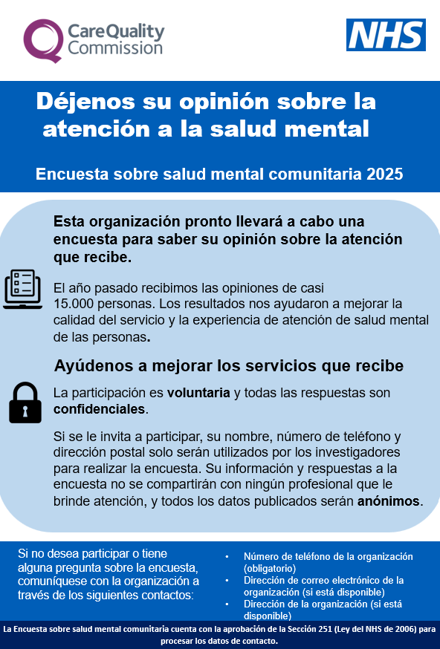
Section 251 requirements: dissent poster and 16/17-year-olds leaflet
Dissent posters give service users the opportunity to opt-out (available on the NHS Surveys website).
Posters should have been displayed during the sampling months (April - May 2025) to comply with Section 251 requirements.
If your trust has not displayed the dissent poster during April and May, you should inform your Caldicott Guardian and gain their approval for continuing to create a sample.
Posters are available in English, and have been translated into the 11 most commonly spoken languages in England as well as languages requested by trusts.
16/17-year-olds leaflet was also produced and should have been shared with service users throughout the sampling period on the trust’s website, display on or around the trust, hand it out to service users.

Slide 34
Demographic Batch Service (DBS) Checks

Slide 35
DBS checks
DBS & local checks requirements
Before mailing 1 | Local checks AND DBS checks at the time of drawing your sample. Further deceased checks will be needed if it has been 2 weeks or more since DBS checks prior to sample submission and mailing 1. This can be conducted by your contractor if they have the capability.
Before SMS 1 | No check required.
Before mailing 2 | Local checks (+ strongly recommended DBS check) If your contractor has the capability to run DBS checks on your behalf these checks can be conducted instead of local checks. However, trusts can still choose to run local checks if they wish. Please check with your contractor.
Before SMS 2 | No check required.
Before mailing 3 | Local checks (+ strongly recommended DBS check) If your contractor has the capability to run DBS checks on your behalf these checks can be conducted instead of local checks. However, trusts can still choose to run local checks if they wish. Please check with your contractor.

Slide 36
DBS requirements
Some contractors have the capability of running DBS checks during fieldwork on the trusts’ behalf.
This removes the requirement for trusts to run DBS checks ahead of mailing two and mailing three BUT:
Trusts may choose to run local checks if they wish.
Trusts are still expected to run the initial DBS checks when drawing the initial sample.
NHS Number and Full date of birth will be required in the sample sent to your contractor to allow them to conduct DBS checks on your behalf during fieldwork.
Please discuss further with your contractor.

Slide 37
Instruction manuals

Slide 38
Survey handbook
For survey leads:
Document outlining step-by-step process for preparing and running the survey.
It is a key summary document that links to all other relevant information regarding the survey handbook.
Includes:
What’s new for the 2025 Community Mental Health Survey (including updated specifications for the online survey tool).
Tips on managing and implementing the survey.
Key dates: top level.
Highlights on key information e.g. Section 251.
This document is now available on the NHS Community Mental Health website .

Slide 39
Sampling instructions
For sample drawers (data team):
Document outlining step-by-step process of how to draw your sample.
Key summary document that links to all other relevant information regarding survey sampling.
Includes:
Overview of the sample drawing process.
Details on eligible and ineligible service users.
Information on DBS checks for deceased service users.
Checking and submitting your sample.
This document is now available on the NHS Community Mental Health website.

Slide 40
Other Documents
Instruction Manuals: Sample Declaration Forms
Instruction Manuals: Sample Construction spreadsheet
To be used to construct the sample of eligible service users for the survey.
Includes all relevant fields for the sample details, mailing details and fieldwork variables.
The sample construction spreadsheet is available for download from the NHS patient survey website.
To be used to check your sample has been correctly drawn before submission to your contractor or the SCC.
Includes – instructions, checklist, declaration agreement.
Must be signed by the sample drawer AND your Caldicott Guardian prior to submission.
The sample declaration form is available for download from the NHS patient survey website.

Slide 41
Generic NPSP Instruction Documents
Other instructional documents that are useful for implementing the 2025 Community Mental Health Survey can be found on the NHS Surveys website:
Patient feedback and the NHS Constitution
Setting up a project team
Data protection and confidentiality
Ethical issues, ethical committees and research governance
Collecting data from non-English speaking populations
Publicising the survey
Implementing the survey – practicalities
Submitting samples
Entering and submitting final data
Making sense of the data
Reporting results
Updated trust-level benchmark reports
Universal glossary

Slide 42
Entering fieldwork

Slide 43
Entering fieldwork early / on time
Entering fieldwork on time or earlier will help your trust to maximise responses rates, providing your trust with more data.
Ensure you have a survey team in place before you start drawing your sample.
Generate your sample promptly - begin preparing now.
Respond to queries as soon as possible to avoid unnecessary delays.
Ensure there is sufficient resourcing around the time of drawing your sample and answering queries – communicate with your team, handover tasks if people are going to be on leave and let your contractor and the SCC know any updates.
If there are any changes in the survey lead, inform your contractor and the Survey Coordination Centre (SCC).

Slide 44
Key dates

Slide 45
Key dates - Overview
Activity | Date
Dissent posters published on website | March 2025
Section 251 approval | 06 June 2025
Publication of sampling materials (follows section 251 approval) | 11 June 2025
Publication of service user-facing materials (follows section 251 approval) | 23 June 2025
Trusts to draw samples | July 2025
Submit sample to contractor | Contractor to confirm
Fieldwork | 18 August – 28 November 2025
Trusts receive local results | Contractor to confirm

Slide 46
Questions

Slide 47
Thank you for your time
A copy of the slides will be on the NHS Surveys website
Contact us:
mentalhealth@surveycoordination.com
01865 208127
Project Team (SCC):
Samantha Guymer (Research Manager), Chris Laws (Senior Research Associate), Anca Postolache (Research Associate).

